Slide 1
Can we predict Covid-19 infection spread?
Veera Reddy Koppula| DSC 500

Slide 2
Objective
I would like to define different search keywords and identify if there is any correlation with observed Covid-19 data from other data sources to see if we can formulate any indicators that could predict the spread of Covid-19 infection further.

Slide 3
Search Topics
Covid-19 Spread rate in US
Covid-19 symptoms
How does Covid-19 spread?
Spread in states with top +ve rates– with restrictions timeline
Google Search Trends
Coronovirus/Covid Symptoms
Do I have Covid/Coronavirus
Covid Testing
Covid Restrictions
Notes:
Summarize your research in three to five points.

Slide 4
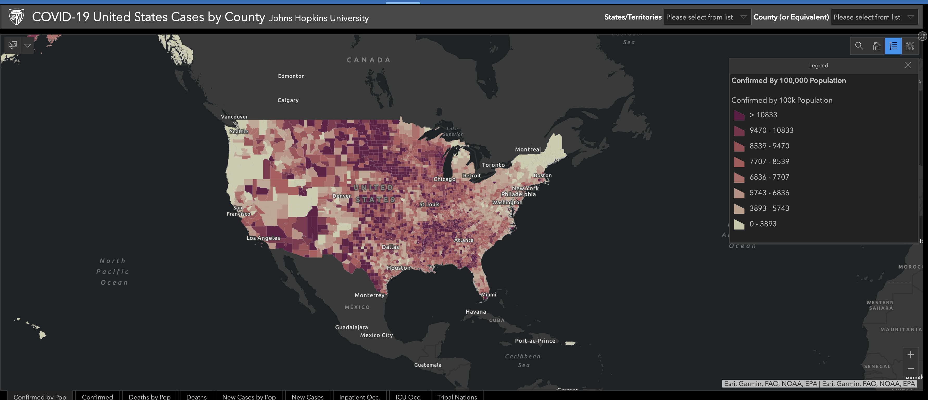
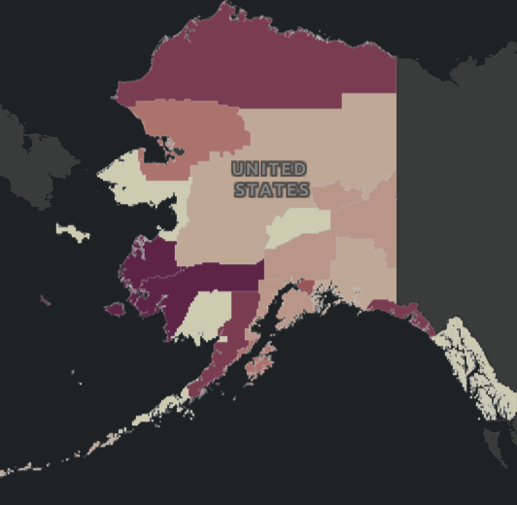
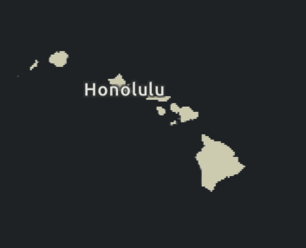
Covid-19 Spread Rates per 100k
Observations:
Higher Positivity rate in Mid-western states like North Dakota, South Dakota, Utah, Tennessee.
Most of the infection spread is centered around metro areas in most of the states, showing a general positive correlation with population density

Slide 5
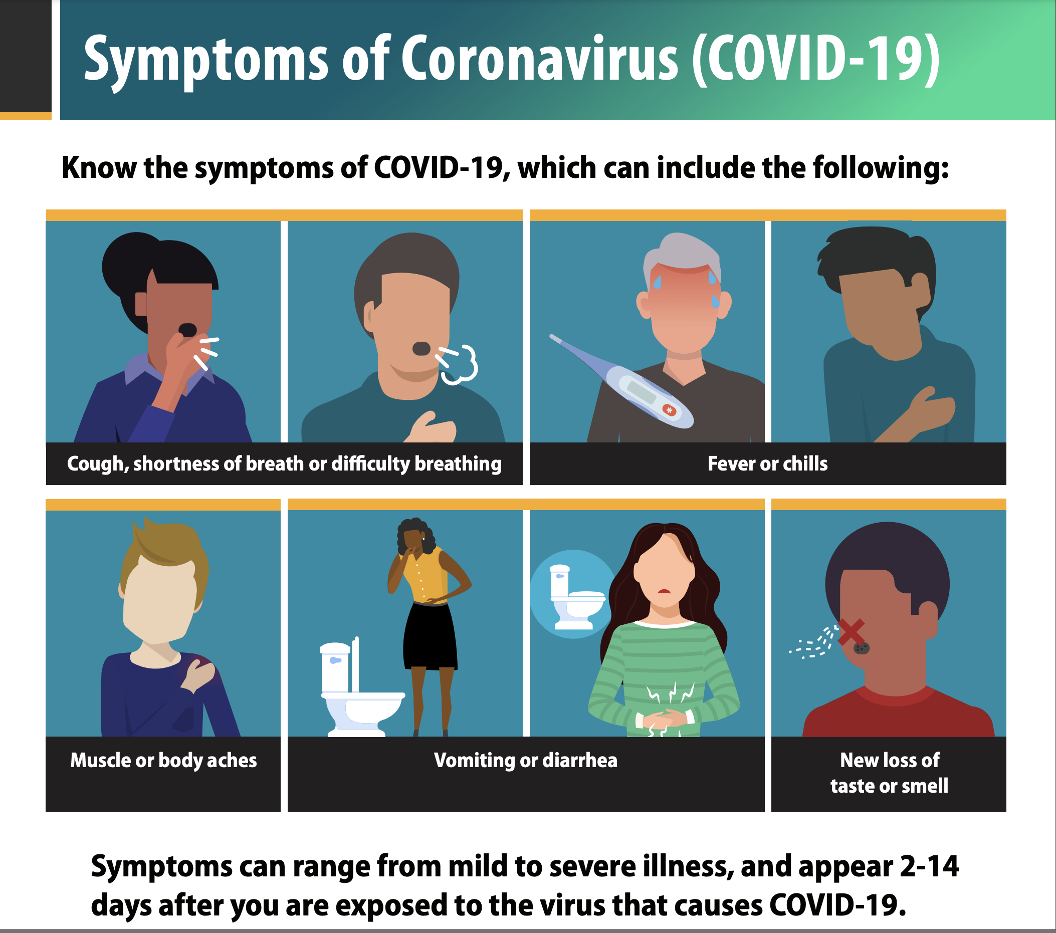
COVID-19 Symptoms
Source: https://www.cdc.gov/coronavirus/2019-ncov

Slide 6
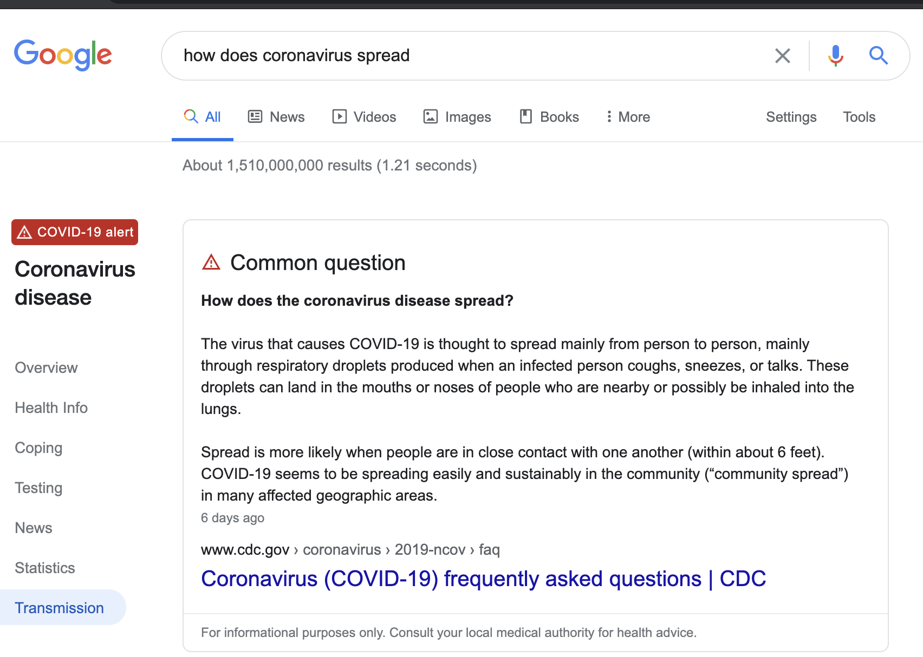
How does Covid-19 Spread?
Observation:
Spread of the virus mainly happens human to human when in close contact

Slide 7
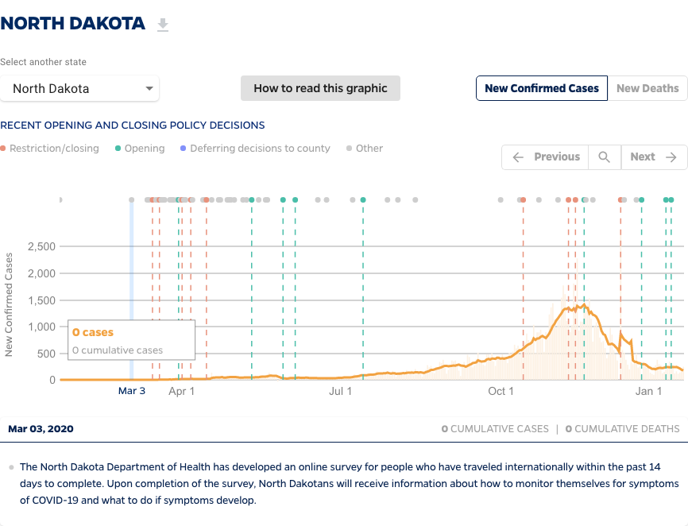
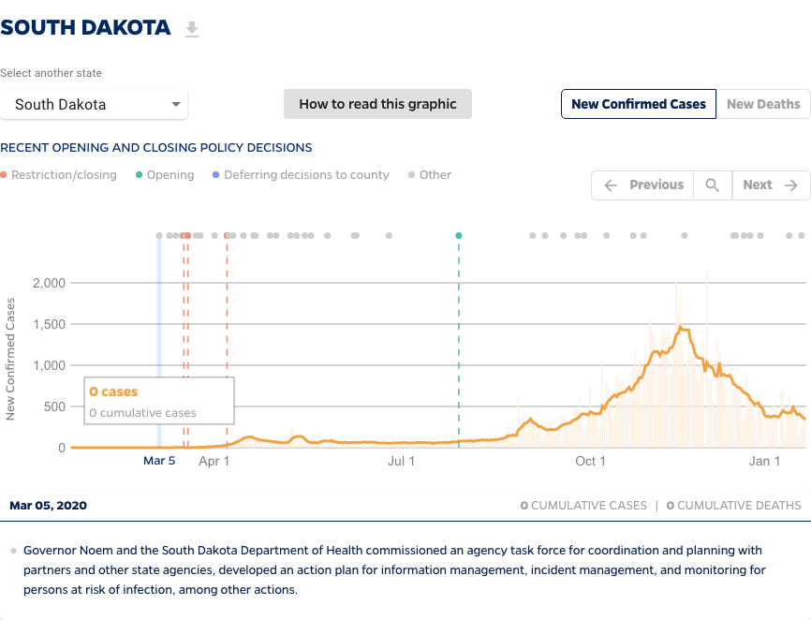
Spread in Top states with measures in place - North Dakota and South Dakota
Observation:
In general, when restrictions in place infection trend seems to be negative

Slide 8
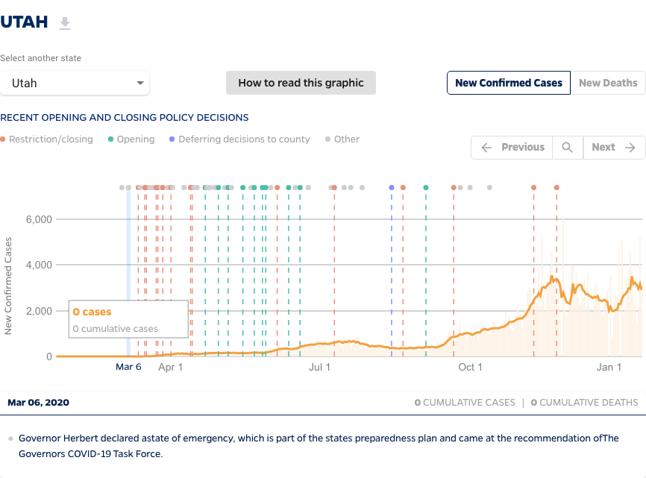
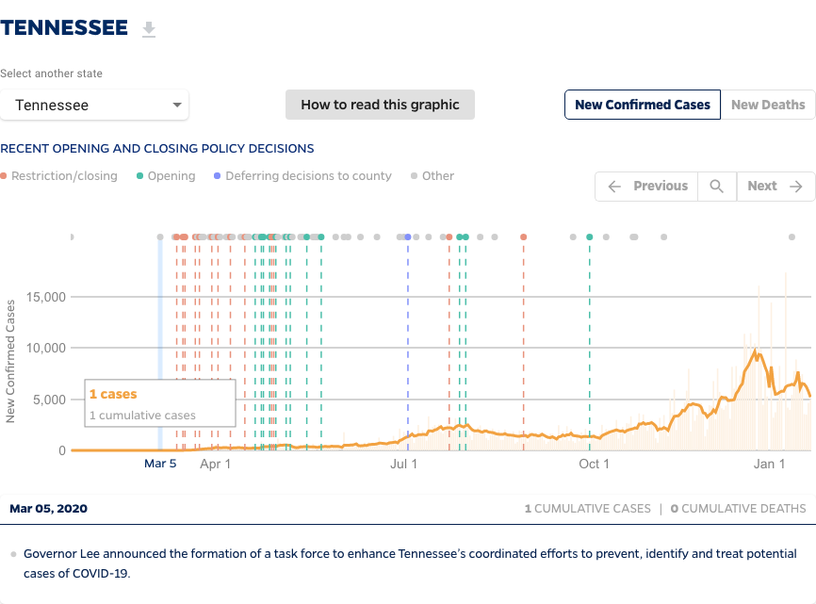
Covid-19 spread in top states with measures in place - Utah and Tennessee
Observation:
In general, when restrictions in place infection trend seems to be negative

Slide 9
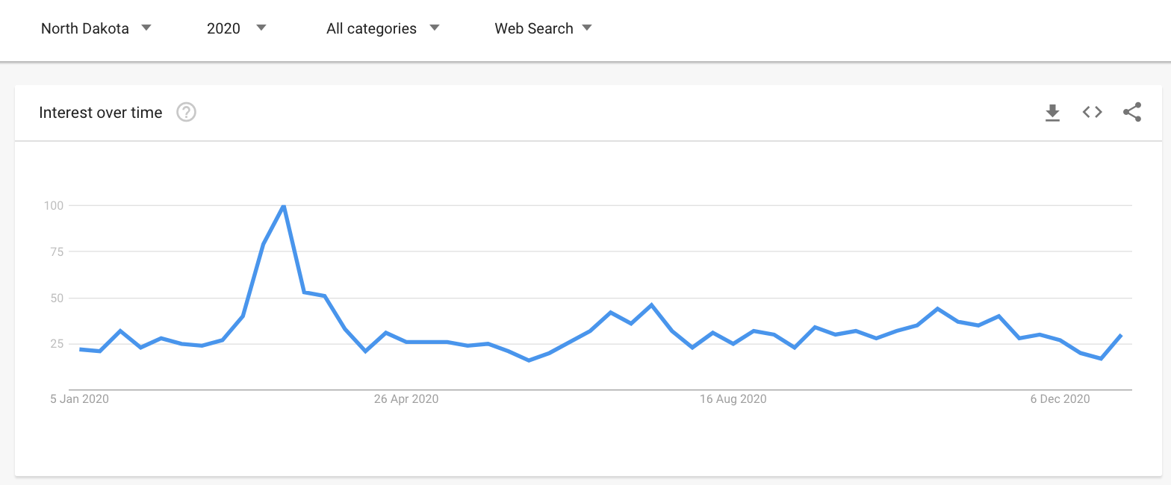
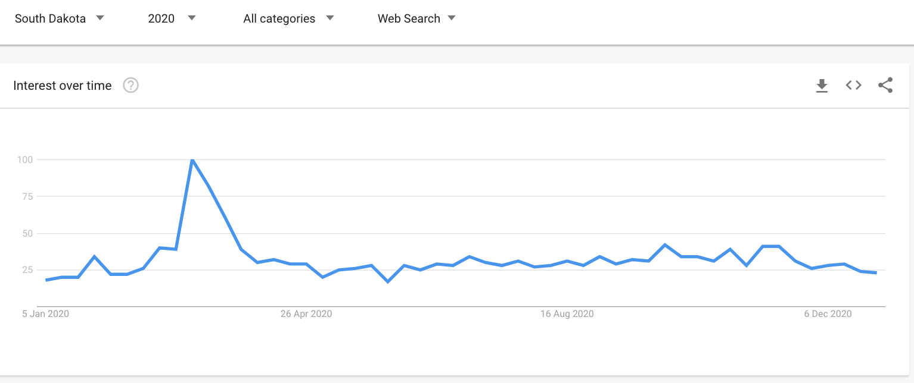
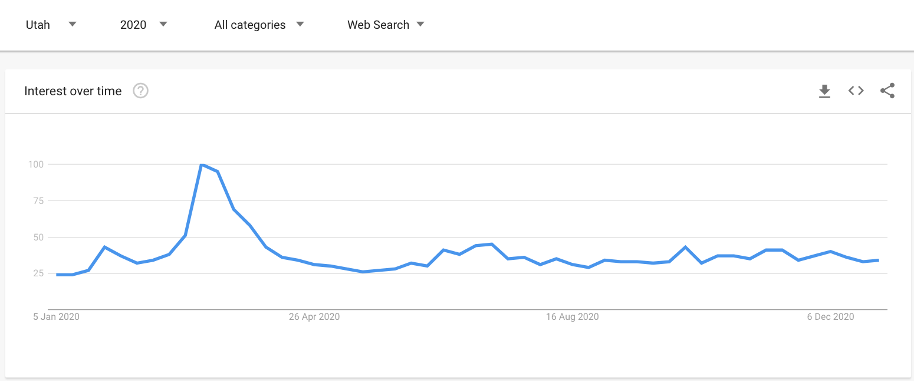
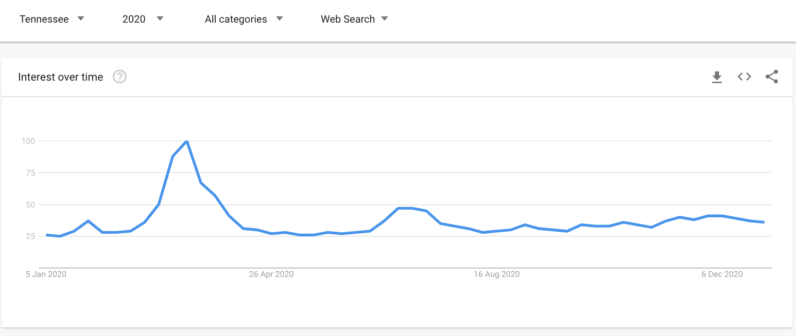
Google search trend - for “ Covid-19 Symptoms” in the top 4 states with covid-19 positivity rates
Observation:
Search for Covid-19 Symptoms does not seem to have strong positive or negative correlation with virus spread

Slide 10
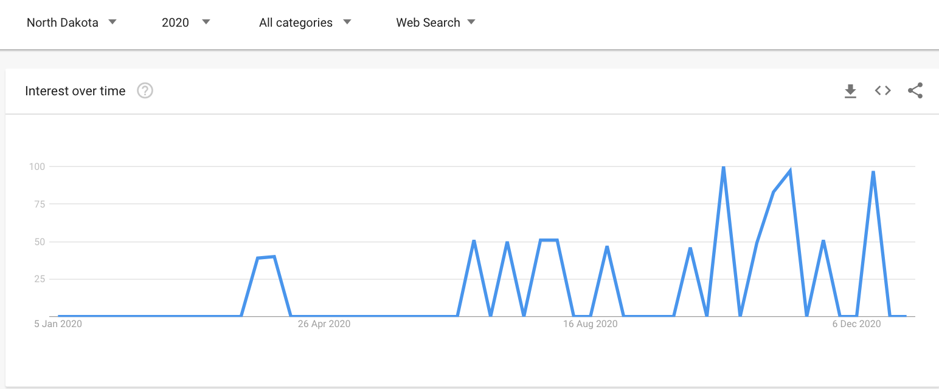
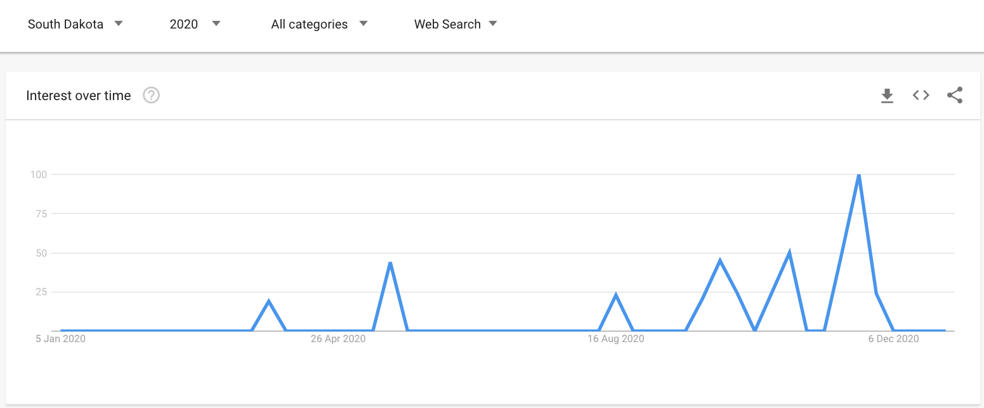
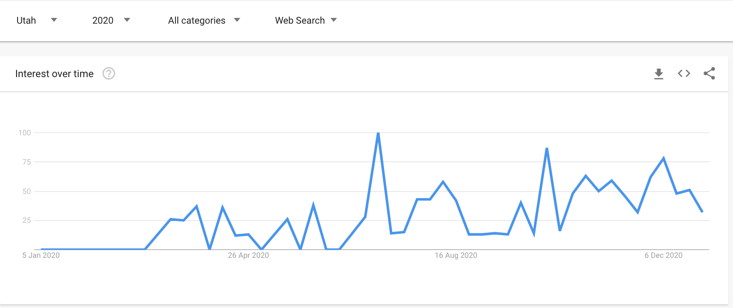
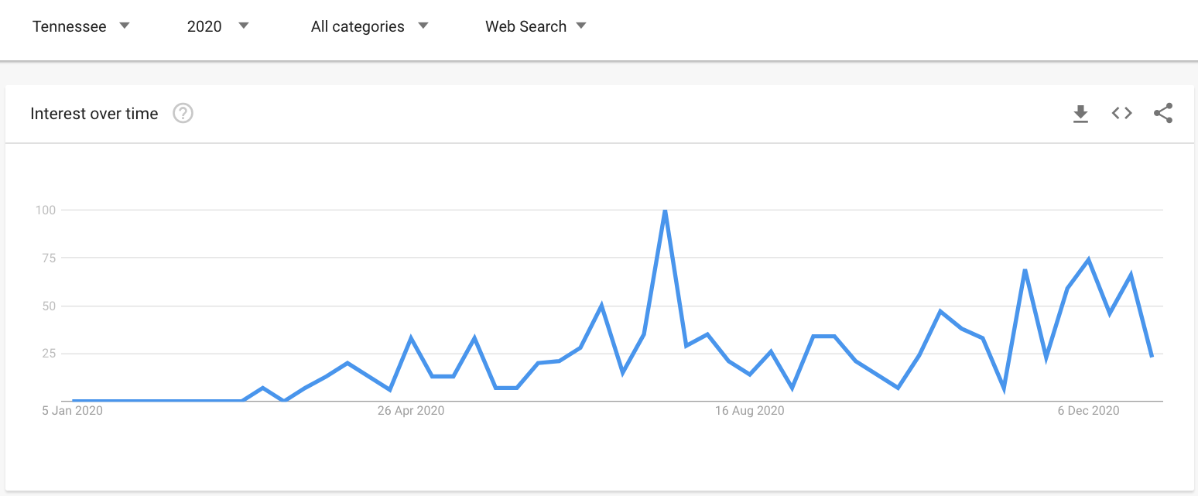
Google search trend - For “ Do I have Covid” in the top 4 states with covid-19 positivity rates
Observation:
Search for Covid symptom Check does seem to have some positive correlation with virus spread

Slide 11
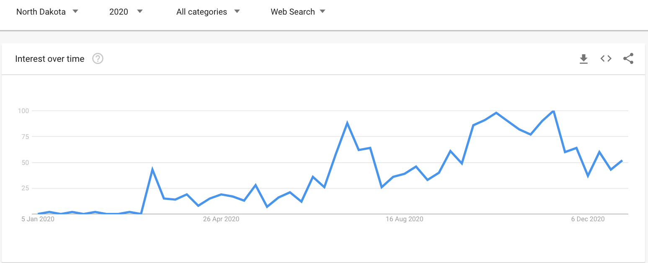
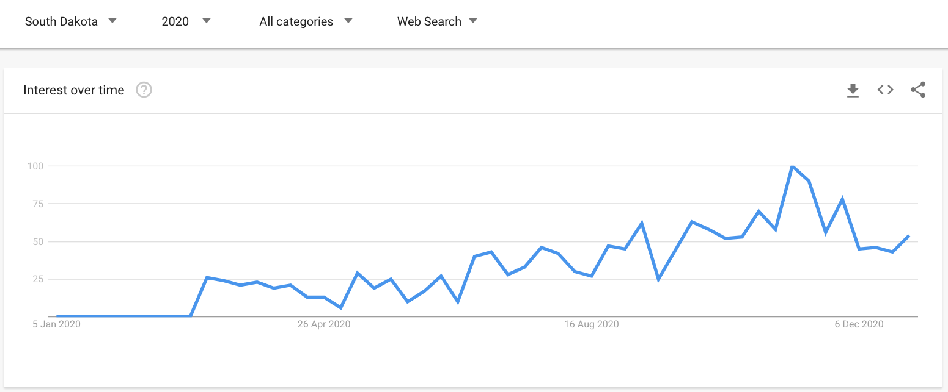
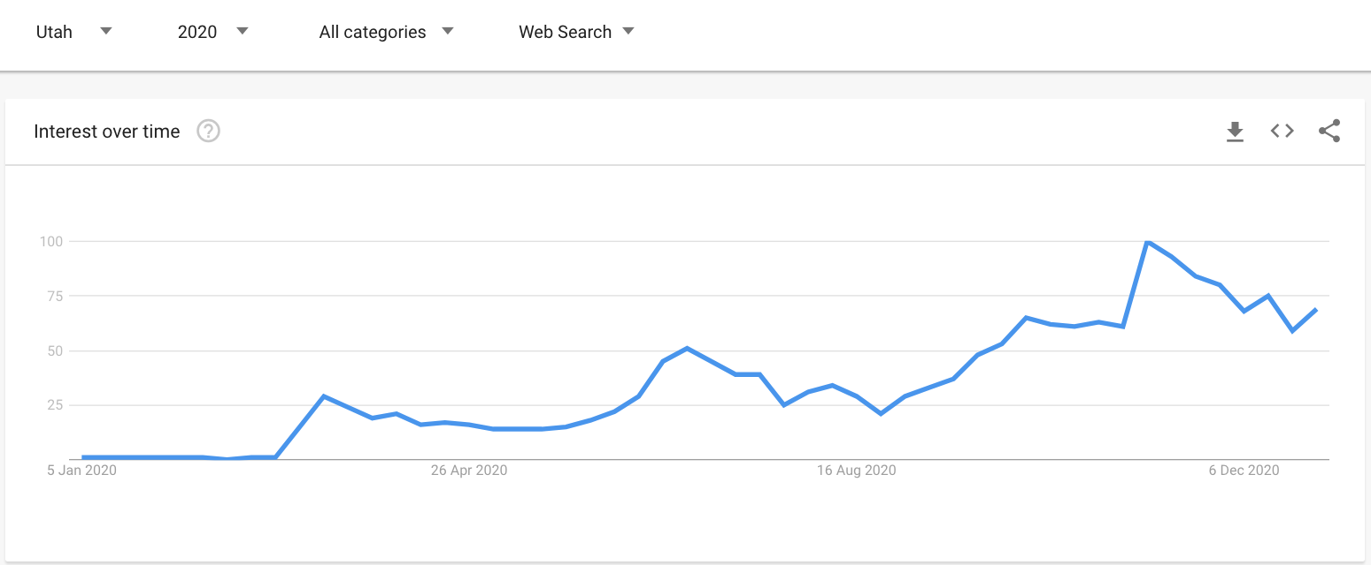
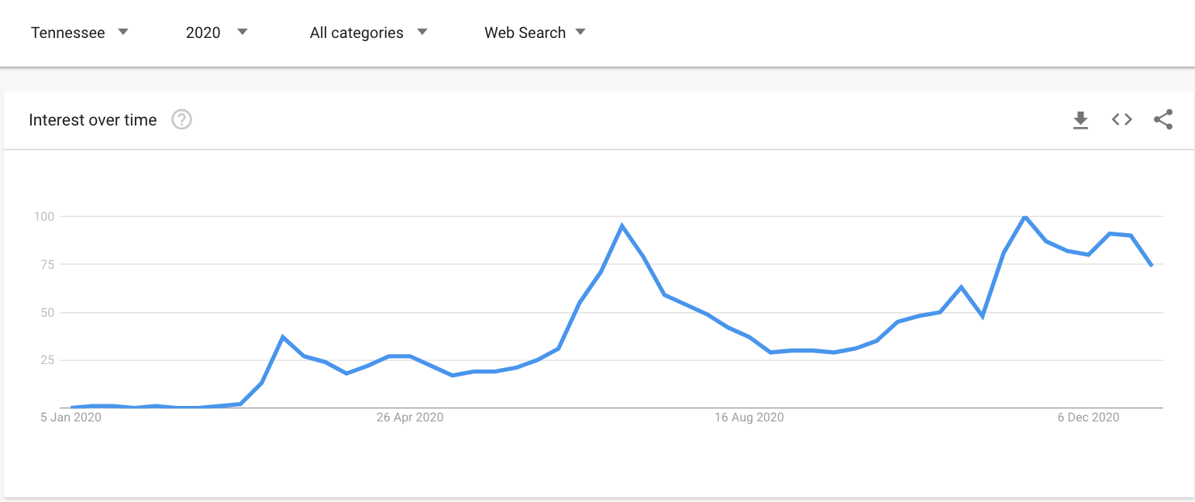
Google search trend - For “ Covid Testing ” in the top 4 states with covid-19 positivity rates
Observation:
Search for Covid Testing has a strong positive correlation with virus spread rate

Slide 12
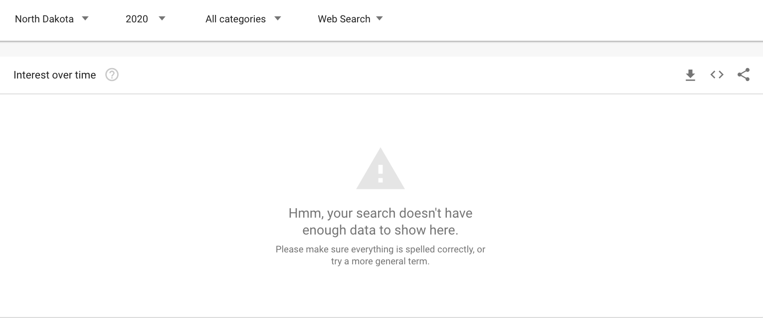
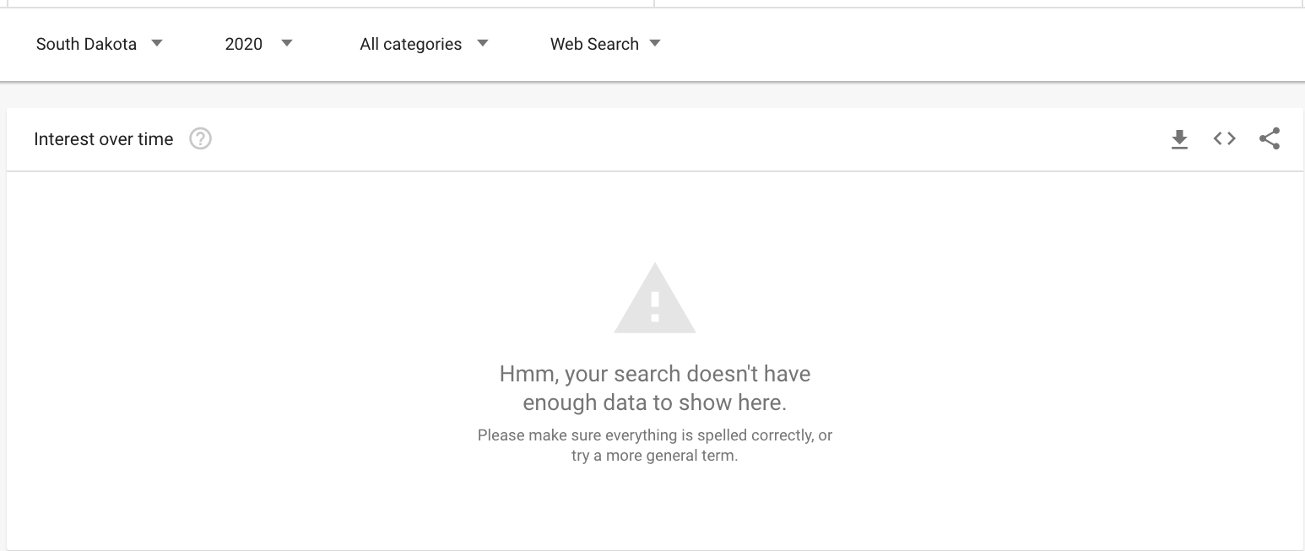
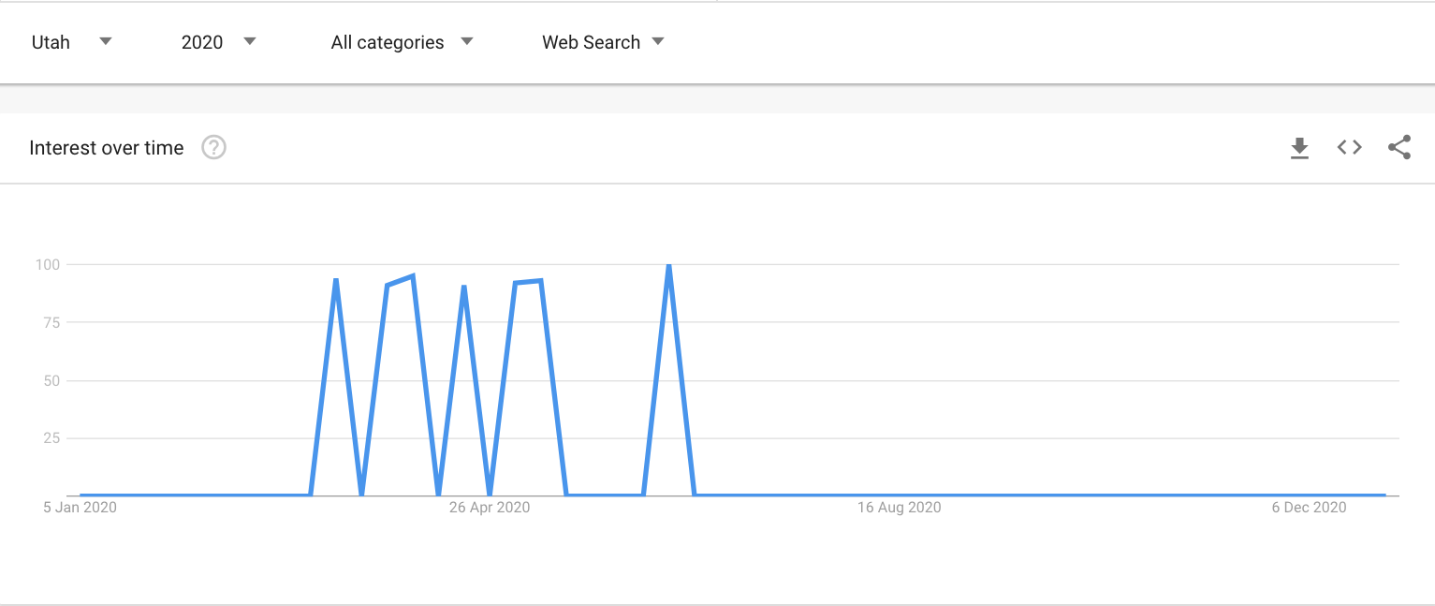
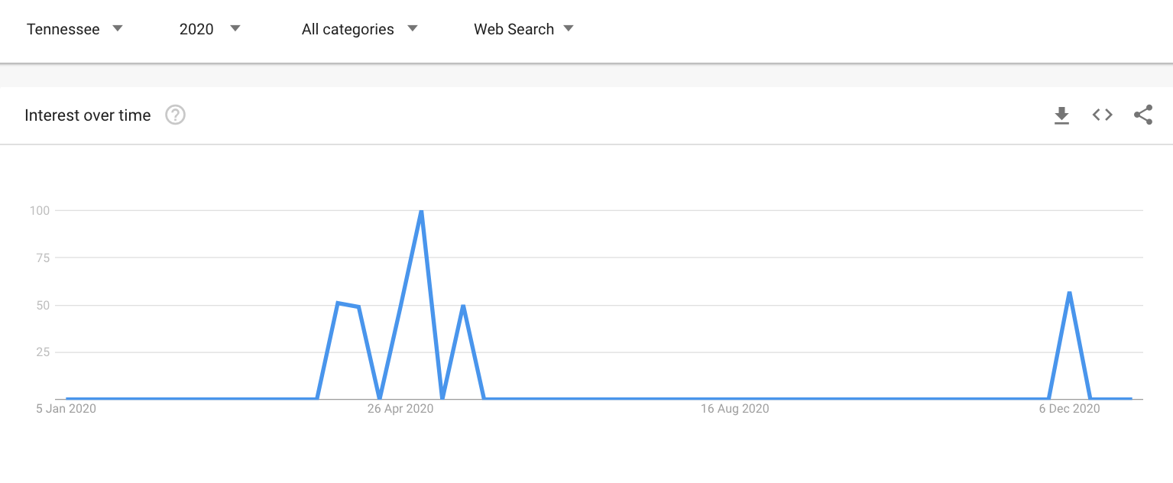
Google search trend - For “ Covid Restrictions” in the top 4 states with covid-19 positivity rates
Observation:
Search for Covid Restrictions has no correlation with virus spread rate

Slide 13
Conclusions
Based on the review for different Google searches 0-Search for COVID-19 testing and Covid symptoms checker have a positive correlation to COVID-19 positivity spread rate.
In general, where people who believe they might have been exposed to the virus would like for options to validate or test for an infection, higher test rate would theoretically could cause drive in higher positivity rate due to collection of larger samples.

Slide 14
References
Google search trends - https://trends.google.com/trends/yis/2020/
John Hopkins Covid data - https://coronavirus.jhu.edu/us-map
Center for Disease control (CDC )- https://www.cdc.gov/coronavirus/2019-ncov

